Slide 1
Question-2

Slide 2
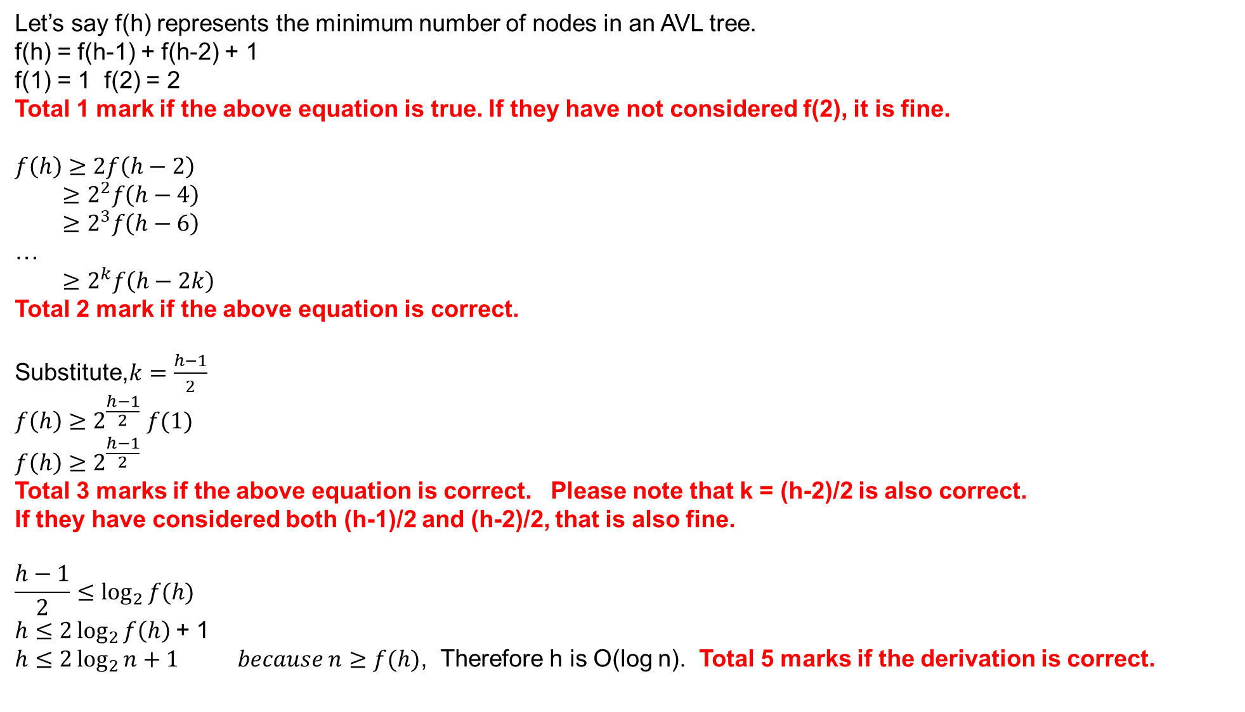
Let’s say f(h) represents the minimum number of nodes in an AVL tree.
f(h) = f(h-1) + f(h-2) + 1
f(1) = 1 f(2) = 2
Total 1 mark if the above equation is true. If they have not considered f(2), it is fine.
$$f\left(h\right)≥2f\left(h−2\right)$$
$$≥2^{2}f\left(h−4\right)$$
$$≥2^{3}f\left(h−6\right)$$
…
$$≥2^{k}f\left(h−2k\right)$$
Total 2 mark if the above equation is correct.
Substitute,$k=\frac{h−1}{2}$
$$f\left(h\right)≥2^{\frac{h−1}{2}} f(1)$$
$$f\left(h\right)≥2^{\frac{h−1}{2}}$$
Total 3 marks if the above equation is correct. Please note that k = (h-2)/2 is also correct.
If they have considered both (h-1)/2 and (h-2)/2, that is also fine.
$$\frac{h−1}{2}≤\log_{2}{f(h)}$$
$h≤2\log_{2}{f\left(h\right) }$+ 1
$h≤2\log_{2}{n}+1 because n≥f(h)$, Therefore h is O(log n). Total 5 marks if the derivation is correct.

Slide 3
Question-3

Slide 4
STEP-1
TOTAL 1 marks if STEP-1 is correct
STEP-2
1
TOTAL 2 marks if STEP-2 is correct
1
2
3
2
3
4
5
*
6
7
*
4
5
13
7
9
8
10
11
13
12
9
8
10
11
6
12
STEP-3
1
STEP-4
TOTAL 3 marks if STEP-4 is correct
1
2
3
*
2
3
*
4
11
13
7
9
11
13
7
9
8
10
5
6
12
4
8
10
5
6
12

Slide 5
STEP-5
STEP-6
1
TOTAL 4 marks if STEP-6 is correct
1
2
13
*
2
13
*
9
11
3
7
9
11
12
7
4
8
10
5
6
12
4
8
10
5
6
3
STEP-7
1
STEP-8
*
TOTAL 5 marks if STEP-8 is correct
1
11
13
11
13
*
9
2
12
7
9
10
12
7
4
8
10
5
6
3
4
8
2
5
6
3

Slide 6
STEP-9
STEP-10
13
13
*
11
1
11
12
9
10
12
7
*
9
10
1
7
4
8
2
5
6
3
4
8
2
5
6
3
STEP-11
13
TOTAL 7 marks if STEP-11 is correct
11
12
9
10
6
7
4
8
2
5
1
3

